Slide 1


The Greedy Method

Slide 2

Outline and Reading
The Greedy Method Technique (§5.1)
Fractional Knapsack Problem (§5.1.1)
Task Scheduling (§5.1.2)
Minimum Spanning Trees (§7.3) [future lecture]

Slide 3
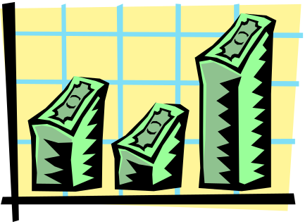
The Greedy Method Technique
The greedy method is a general algorithm design paradigm, built on the following elements:
  configurations: different choices, collections, or values to find
  objective function: a score assigned to configurations, which we want to either maximize or minimize
It works best when applied to problems with the greedy-choice property:
  a globally-optimal solution can always be found by a series of local improvements from a starting configuration.

Slide 4

Making Change
Problem: Accept n dollars, to return a collection of coins with a total value of n dollars.
Configuration: A collection of coins with a total value of n
Objective function: Minimize number of coins returned.
Greedy solution: Always return the largest coin you can
Example 1: Coins are valued $.32, $.08, $.01
  Has the greedy-choice property, since no amount over $.32 can be made with a minimum number of coins by omitting a $.32 coin (similarly for amounts over $.08, but under $.32).
  For a certain amount (y) over a coin dimension (x), if we can reach it using coins (<x) with a total n coins, then we can also use coin x with ≤ n coins.
Example 2: Coins are valued $.30, $.20, $.05, $.01
  Does not have greedy-choice property, since $.40 is best made with two $.20’s, but the greedy solution will pick three coins (which ones?)

Slide 5


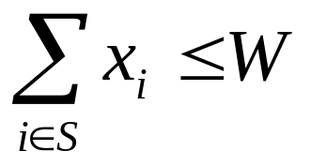
The Fractional Knapsack Problem
Given: A set S of n items, with each item i having
  b_{i} - a positive benefit
  w_{i} - a positive weight
Goal: Choose items with maximum total benefit but with weight at most W.
If we are allowed to take fractional amounts, then this is the fractional knapsack problem.
  In this case, we let x_{i} denote the amount we take of item i
  Objective: maximize
  Constraint:

Slide 6

Example
Given: A set S of n items, with each item i having
  b_{i} - a positive benefit
  w_{i} - a positive weight
Goal: Choose items with maximum total benefit but with weight at most W.
“knapsack”
Solution:
1 ml of 5
2 ml of 3
6 ml of 4
1 ml of 2
Items:
1
2
3
4
5
Weight:
4 ml
8 ml
2 ml
6 ml
1 ml
Benefit:
$12
$32
$40
$30
$50
10 ml
Value:
3
4
20
5
50
($ per ml)

Slide 7
The Fractional Knapsack Algorithm
Greedy choice: Keep taking item with highest value (benefit to weight ratio)
  Use a heap-based priority queue to store the items, then the time complexity is O(n log n).
Correctness: Suppose there is a better solution
  there is an item i with higher value than a chosen item j (i.e., v_{j}<v_{i}) , if we replace some j with i, we get a better solution
  Thus, there is no better solution than the greedy one
Algorithm fractionalKnapsack(S, W)
Input: set S of items w/ benefit b_{i} and weight w_{i}; max. weight W Output: amount x_{i} of each item i to maximize benefit with weight at most W
for each item i in S
  x_{i} ← 0
  v_{i} ← b_{i} / w_{i} {value}
  w ← 0 {current total weight}
  while w < W
  remove item i with highest v_{i}
  x_{i} ← min{w_{i} , W − w}
  w ← w + min{w_{i} , W − w}

Slide 8

Task Scheduling
Given: a set T of n tasks, each having:
  A start time, s_{i}
  A finish time, f_{i} (where s_{i} < f_{i})
Goal: Perform all the tasks using a minimum number of “machines.”
Machine 3
Machine 2
Machine 1
1
2
3
4
5
6
7
8
9

Slide 9
Task Scheduling Algorithm
Greedy choice: consider tasks by their start time and use as few machines as possible with this order.
  Run time: O(n log n).
Correctness: Suppose there is a better schedule.
  We can use k-1 machines
  The algorithm uses k
  Let i be first task scheduled on machine k
  Task i must conflict with k-1 other tasks
  K mutually conflict tasks
  But that means there is no non-conflicting schedule using k-1 machines
Algorithm taskSchedule(T)
Input: set T of tasks w/ start time s_{i} and finish time f_{i}
Output: non-conflicting schedule with minimum number of machines
m ← 0 {no. of machines}
  while T is not empty
  remove task i w/ smallest s_{i}
  if there’s a machine j for i then
  schedule i on machine j
  else
  m ← m + 1
  schedule i on machine m

Slide 10
Example
Given: a set T of n tasks, each having:
  A start time, s_{i}
  A finish time, f_{i} (where s_{i} < f_{i})
  [1,4], [1,3], [2,5], [3,7], [4,7], [6,9], [7,8] (ordered by start)
Goal: Perform all tasks on min. number of machines
Machine 3
Machine 2
Machine 1
1
2
3
4
5
6
7
8
9

